Slide 1
Threats and measures for telecoms: the NIS2 approach
62nd FITCE Congress - Athens 2023
Georgia Bafoutsou
Cybersecurity Officer
Policy Development and Implementation Unit
ENISA
28
09
2023

Slide 2

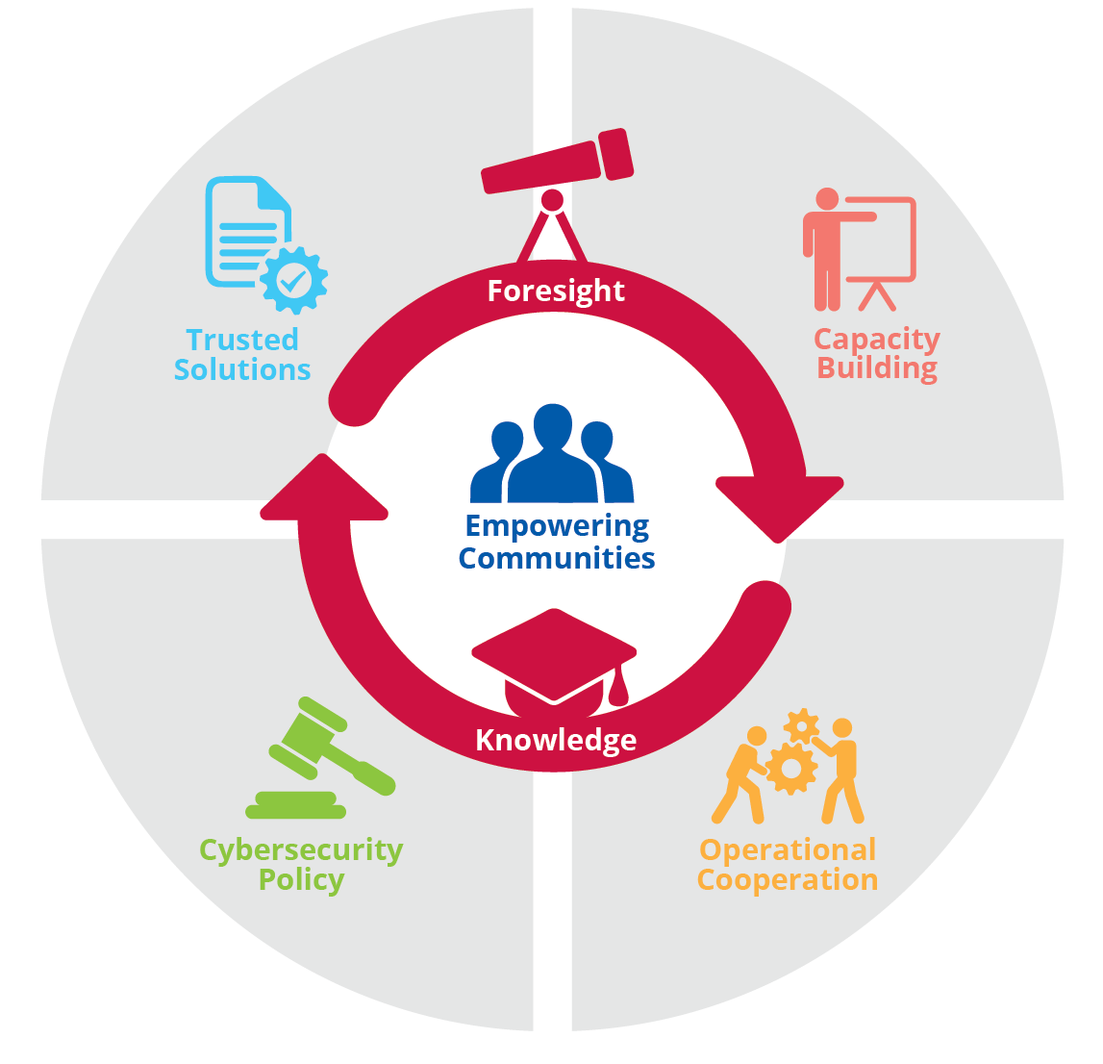
ROLE OF ENISA – WHO WE ARE
62nd FITCE Congress - Athens 2023
A TRUSTED AND CYBER SECURE EUROPE
Our mission is to achieve a high common level of cybersecurity across the Union in cooperation with the wider community
Notes:
For those of you who may not be familiar with the EU Agency for Cybersecurity, ENISA is part of the whole EU institutions, agencies and bodies ecosystem and we serve as the EU center or expertise for cybersecurity. ENISA’s mission is to achieve a high common level of CS across the EU and in order to achieve that, we engage in a number of activities that can more or less include in 4 main areas.
First of all, ENISA supports the development and implementation of CS policy and regulatory framework across the EU with a view towards achieving a harmonized implementation of the regulatory context.
Second, ENISA works on activities related to standardization and certification for the development of trusted solutions, so e.g. ENISA is responsible for drafting the candidates CS certification schemes under the EU CS certification framework.
Next, ENISA engages in so called capacity building activities, so these are activities like the organization of CS exercises, trainings or drafting of good practices to improve the CS capabilities across MS and operators.
Finally, ENISA facilitates operational cooperation, for e.g. we facilitate the sharing of information and collaboration between national CSIRTs, and in cased of large-scale cross-border incidents.
At the center of our activities is what we call Community Building. So, we work with stakeholders from the EU and national policy side, from the regulatory side we work with operators and the industry, and we try to bring together different stakeholders from different areas and to collaborate and exchange good practices and work together to build up the EU CS resilience. (So, again, I would like to thank you for giving me this opportunity to connect)

Slide 3

ENISA’s Threat LANDSCAPE 2022
Notes:
July 2021-June 2022

Slide 4

Enisa threat landscape 2022
62nd FITCE Congress - Athens 2023
Impact of geopolitics on the cybersecurity threat landscape
Threat actors increasing their capabilities
Ransomware and attacks against availability rank the highest during the reporting period
Novel, hybrid and emerging threats are marking the threat landscape with high impact
Notes:
There was heavy impact of geopolitics,
The conflict between Russia-Ukraine reshaped the threat landscape and we noticed destructive attacks of state-sponsored actors
Threat actors became increasingly capable, utilizing zero-day exploits
Significant rise on attacks against availability, particularly DDoS
with the ongoing war being the main reason behind such attacks.
Phishing is once again the most common vector
The Pegasus case triggered media coverage and governmental actions
Machine Learning (ML) models are at the core of modern distributed systems and are increasingly becoming the target of attacks.
o AI-enabled disinformation and deepfakes.

Slide 5
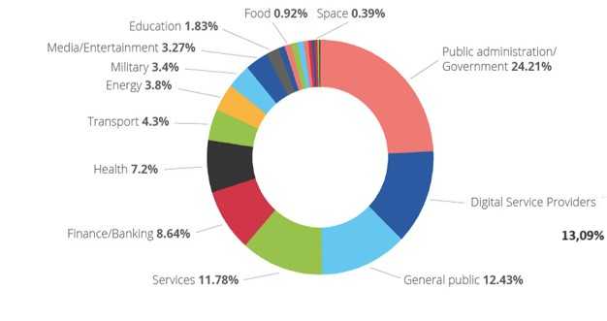
Sectors breakdown
62nd FITCE Congress - Athens 2023
Large number of incidents targeting public administration (24.21%) and government and digital service providers (13,09%)
Notes:
During this reporting period, we again observed a large number of incidents targeting public administration and government and digital service providers. The latter is to be expected given the horizontal provisioning of services for this sector and thus its impact on many other sectors. We also observed a significant number of incidents targeting end users and not necessarily a particular sector. Interestingly, the finance sector faced a consistent number of incidents throughout the reporting period with the health sector following it close behind.

Slide 6
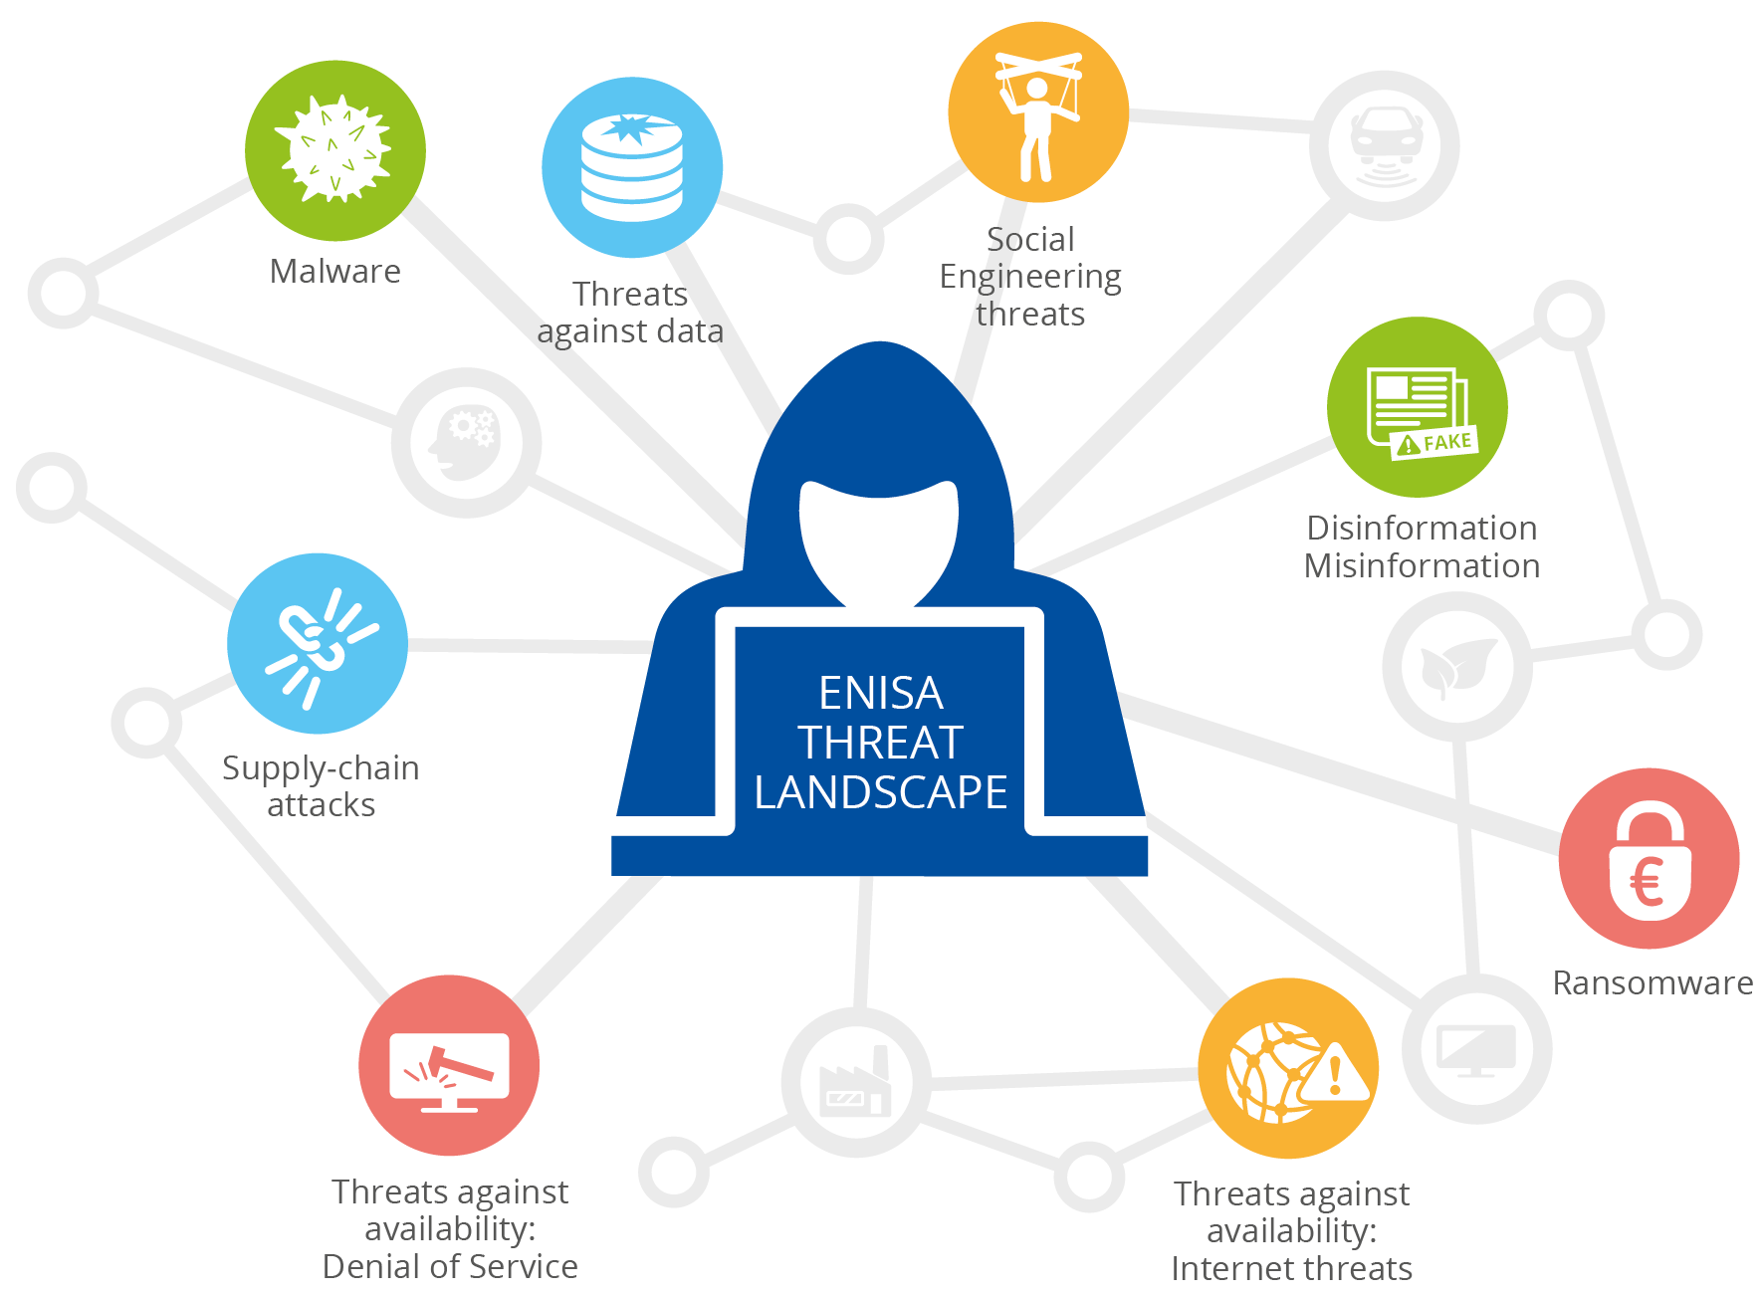
Prime threats
62nd FITCE Congress - Athens 2023
Ransomware
Malware
Social engineering
Threats against data
Threats against availability
Disinformation – misinformation
Supply chain targeting
Notes:
Ransomware:
60% of affected organisations may have paid ransom demands
Malware:
66 disclosures of zero-day vulnerabilities observed in 2021
Social engineering:
Phishing remains a popular technique but we see new forms of phishing arising such as spear-phishing, whaling, smishing and vishing
Threats against data:
Increasing in proportionally to the total of data produced
Threats against availability:
Largest Denial of Service (DDoS) attack ever was launched in Europe in July 2022;
Internet: destruction of infrastructure, outages and rerouting of internet traffic.
Disinformation – misinformation:
Escalating AI-enabled disinformation, deepfakes and disinformation-as-a-service
Supply chain targeting:
Third-party incidents account for 17% of the intrusions in 2021 compared to less than 1% in 2020

Slide 7
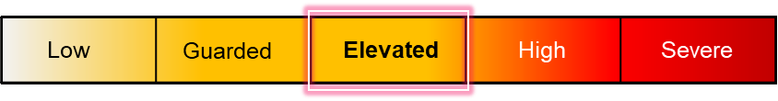
DIGITAL INFRASTRUCTURE SECTOR
62nd FITCE Congress - Athens 2023
In 2023, the European threat level has been maintained at ELEVATED*.
Remarks:
Consistent and continued targeting of European-based digital infrastructure entities:
  by hacktivists largely through low-impact attacks against public-facing targets such as websites and customer portals
  by ransomware operators, including Cl0p, LockBit and Medusa
Notable vulnerabilities:
Ivanti Endpoint Mobile Manager (EPMM) – CVSS 10.0
MOVEit (big file transfer web application) – CVSS 9.8
* Based on ENISA’s CTI provider data and analysis
Notes:
VULNERABILITIES (CVSS: Common Vulnerability Scoring System)
Ivanti Endpoint Mobile Manager (EPMM)
Ivanti stated that the vulnerability was known to be actively exploited in the wild and that clients using EPMM had been impacted.
EPMM contains an authentication bypass where remote, unauthorised attackers can access 'restricted functionality or resources'
an attacker has read/write privileges via the API up to creating new administrator accounts and with full access to Personally Identifiable Information (PII).
Exploitation of a critical vulnerability in MOVEit (big file transfer web application),
Dozens of victims on the group’s leak site
Likely hundreds of organisations and secondary firms are affected, including digital infrastructure providers.

Slide 8

SUMMARY
62nd FITCE Congress - Athens 2023
Threat actors use whatever is more relevant and evolve and adapt to the changing of technologies
Good practices and coordinated actions are important to reach a common high level of cybersecurity.
Cyber attacks has increased by a lot compared to last year but we still lack the visibility
Information Sharing is caring…
It helps potential victims , it helps researchers.. it also helps cybersecurity authorities and ENISA

Slide 9



NIS and NIS2 DIRECTIVES

Slide 10
Eu policy context
62nd FITCE Congress - Athens 2023
2010
2017
2020
2022
2023
2008
2013
2015
2016
2017
2018
2019
2020
2022
2023
ECI Directive 2008/114/EC
Proposal for a Cybersecurity Competence Centre
EU Cyber security strategy
NIS Directive 2016/1148
- Cybersecurity Act 2019/881
- Agreement on the proposal for CCC
EU Cyber
Solidarity Act
CRA
Digital Single Market
More proposals
- Cybersecurity Act
- Coordinated Response to Large Scale Incidents
- New EU Cybersecurity Strategy
- NISD2.0
- Review of the ECI Directive (CER Directive)
Stuxnet
WannaCry
SolarWinds
Notes:
In this graph we can observe the development of EU policies since 2008.
It’s not necessary to dive into that, however, it is interesting to note that major policy initiatives were triggered after big cyber attacks, such as Stuxnet that set the scene for NIS1, Wannacry showing the need for the update of NIS to NIS2 and finally Solarwinds attack demonstrating the need for policies strengthening supply chain security, such as the Cyber Resilience Act (CRA), a legal framework that describes the cybersecurity requirements for hardware and software products placed on the market of the European Union.
Stuxnet, malicious computer worm targeting programmable logic controllers (PLCs), which allow the automation of electromechanical processes such as those used to control machinery and industrial processesset the scene for NIS1
Wannacry ransomware attack was another milestone crisis. It affected many sectors and showed the need for the update of NIS to NIS2. The attack was estimated to have affected more than 300,000 computers
Solarwinds was a major hit for supply chains
In 2020, a major cyberattack suspected to have been committed by a group backed by the Russian government penetrated thousands of organizations globally leading to a series of data breaches. It was a supply chain attack on Microsoft cloud services and on SolarWinds's Orion software, widely used in government and industry.
NIS2 covering supply chains and Crisis Management

Slide 11
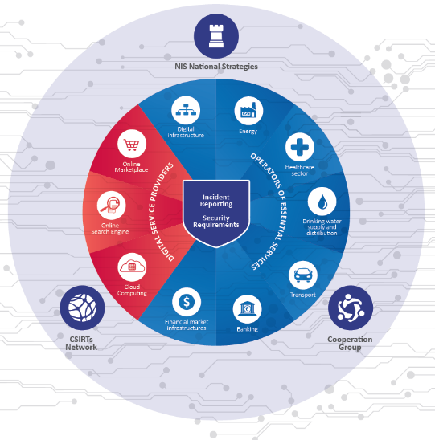
The NIS Directive
62nd FITCE Congress - Athens 2023
Notes:
When it comes to the EU CS policy and regulatory framework, the key instrument is the Network and Information Security Directive, or NIS Directive, which aims at ensuring the CS and resilience of critical sectors and so-called essential services. So, you are probably familiar with the compliance aspects of the NIS Directive, which have to do with security obligations for OES, and the obligations of reporting of incidents of significant impact, but the NIS Directive goes beyond that and establishes the means by which the MS and the European Commission can collaborate in the context of CS.
So, for instance the Cooperation Group has been established to provide the strategy governance for the implementation of the NIS Directive and also have strategic discussion on the next steps of the development of the EU policy and regulatory framework. And the CSIRT Network, which is the technical and operational counterpart of the Cooperation Group, where for instance national CSIRTs can work together and exchange information in cases of large-scale cross-border incidents.
The Cooperation Group is comprised by several Workstream focused specific areas and sectors, and one of these Workstreams is dedicated to Security Measures and Coordinated Vulnerability Disclosure.

Slide 12

NISD Main challenges
62nd FITCE Congress - Athens 2023
Great inconsistencies and gaps due to the NIS scope being de facto defined by MS (case by case OES identification)
Not all sectors that may be considered critical are in scope
Diverging security requirements across MS
Voluntary and ad-hoc cooperation and info sharing between MS and between operators
Diverging incident notification requirements
Ineffective supervision and limited enforcement
Notes:
NISD has contributed to improving the level of cybersecurity across the EU
Difficulties in assessing, monitoring and reviewing the National Cybersecurity Strategies Different levels of maturity in the incident response capabilities domain from one sector to another
Many MS include more sectors than those in Annex II of the Directive
Identification of OES is not based on harmonized approaches
Different reporting thresholds
Coexistence with other regulatory frameworks (e.g. NISD, GDPR, CSA)
Collaboration with private sector is missing

Slide 13
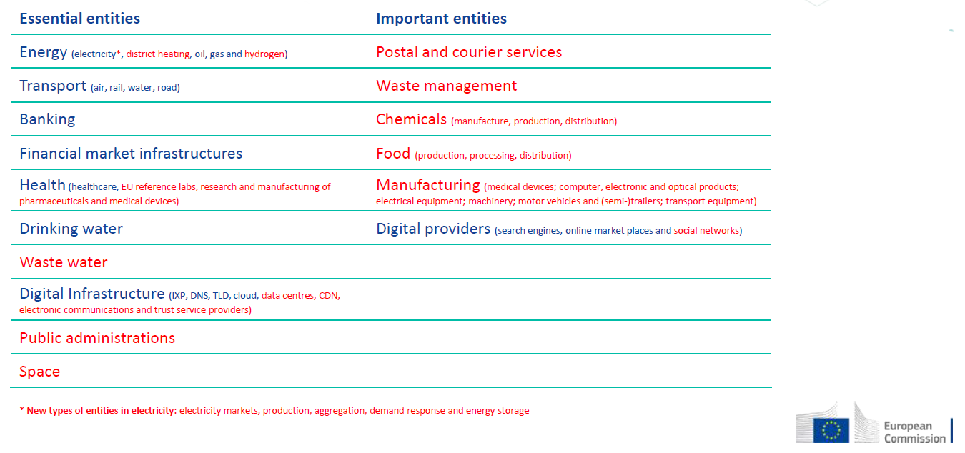
Nis2 - Which entities are covered?
62nd FITCE Congress - Athens 2023
Notes:
the NIS2 proposal deals on the lessons learned from the implementation of the NIS Directive, and tries to achieve even greater harmonization in how for example OES are identified, or what are the baseline security requirements for OES, but it also introduces several new elements of interest such as the CVD and the EU VDB.

Slide 14
Security measures
62nd FITCE Congress - Athens 2023
Risk analysis and information system security;
Incident handling;
Business continuity and crisis management;
Supply chain security -relationships between each entity and its direct suppliers or service providers;
Security in network and information systems acquisition, development and maintenance - vulnerability handling and disclosure;
Assess the effectiveness of cybersecurity risk-management measures;
use of cryptography and, where appropriate, encryption;
Basic cyber hygiene practices and cybersecurity training;
Human resources security, access control policies and asset management;
Use of multi-factor authentication
.
Notes:
Member States shall ensure that essential and important entities take appropriate and proportionate technical, operational and organisational measures to manage the risks posed to the security of network and information systems which those entities use for their operations or for the provision of their services, and to prevent or minimise the impact of incidents on recipients of their services and on other services

Slide 15
Incident reporting
62nd FITCE Congress - Athens 2023
An incident shall be considered to be significant if:
(a) it has caused or is capable of causing severe operational disruption of the services or financial loss for the entity concerned;
(b)it has affected or is capable of affecting other natural or legal persons by causing considerable material or non-material damage
2 elements that are both to be
considered when it comes to
defining incidents:
Event compromising:
  Availability
  Authenticity
  Integrity
  Confidentiality
Event having impact on:
  Stored, transmitted or processed data
  Services offered by, or accessible via, network and information systems
  An event is defined as an incident when it covers any combination
  of the elements above.
.
Notes:
An incident shall be considered to be significant if:
(a) it has caused or is capable of causing severe operational disruption of the services or financial loss for the entity concerned;
(b)it has affected or is capable of affecting other natural or legal persons by causing considerable material or non-material damage
Based on the input received on the survey of MS feedback organized by WS3, the following principles for defining criteria for notification have been drawn.
Moving away from quantitative absolute values for incident notification;
Qualitative criteria based on proportional values, when applicable;
Proportionality refers to the size of operations/services of an important and essential entity.
Notion of significance applies to important and essential entity.
Criteria are non-exclusive, meeting any of the criteria is sufficient for an incident to be reportable;
Horizontal criteria for notification for all sectors, when applicable;
Implement the proportionality principle provided by the NIS2 Directive;
Sector specific criteria in addition to horizontal ones to account for sectorial intricacies.
Each essential and important entity to define, when possible, on its own the following information (this is based on Art. 23(3), whereby it is necessary to define “severe operational disruption of the services or financial loss for the entity concerned”):
Number of users registered, namely the (important and essential) entity’s user base, if applicable/measurable.
Type of service/data delivery, e.g. DNS service providers queries per hour, TLD name registries requests per hour, cloud computing service providers number of user requests per hour, datacenter service providers number of user requests per hour or number of data server per hour, content delivery network providers number of data served per hour or number of user requests per hour, managed service providers number of user requests per hour, managed security service providers number of user requests per hour, online marketplaces number of purchases per hour, online search engines number of user queries per hour, social networking services platforms number of active users per hour and number of users posts per hour, telecommunication user hours, number independent interpersonal communication services number of active users per hour MWh output, data usage / per hour in parallel with # users, number of ships in port per hour, number of patient requests per day, etc. The listing is not meant to be exhaustive.
Revenue for service/data delivery per annum (possibility to extrapolate to daily/hourly etc.).

Slide 16
INCIDENT REPORTING
62nd FITCE Congress - Athens 2023
Notification of significant incidents
.
24h
Early warning
72h
Update the information
Initial assessment
To CSIRT or Competent Authority
1 month
Final report
Notes:
The CSIRT or the competent authority shall provide, without undue delay and where possible within 24 hours of receiving the early warning referred to in paragraph 4, point (a), a response to the notifying entity, including initial feedback on the significant incident and, upon request of the entity, guidance or operational advice on the implementation of possible mitigation measures.

Slide 17
Thank you for your attention! ! !
62nd FITCE Congress - Athens 2023
Georgia Bafoutsou
Cybersecurity Officer
ENISA
Georgia.Bafoutsou@enisa.europa.eu

